Slide 1

Digital Portfolio
Name: Krishnakumar.M
Register.no: unm1397222405946
NMID: 623F01034345314B3DB45716EF27FB80
Department: BSc. Computer Science
College: SRM ARTS AND SCIENCE COLLEGE
University: Madras University

Slide 2
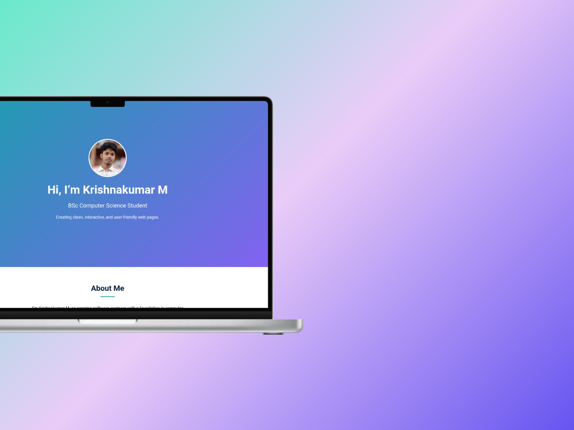
Digital
Portfolio
PRESENTED BY
Krishnakumar M.

Slide 3


Agenda
1. Problem Statement
2. Project Overview
3. End Users
4. Tools & Technologies
5. Portfolio Design and Layout
6. Features and Functionality
7. Key Sections of Portfolio
8. GitHub Link
8. Conclusion

Slide 4
Problem Statement
Creating a portfolio website is essential for effectively showcasing skills, projects, and experiences, overcoming the limitations of traditional resumes and enhancing visibility to recruiters and examiners.

Slide 5
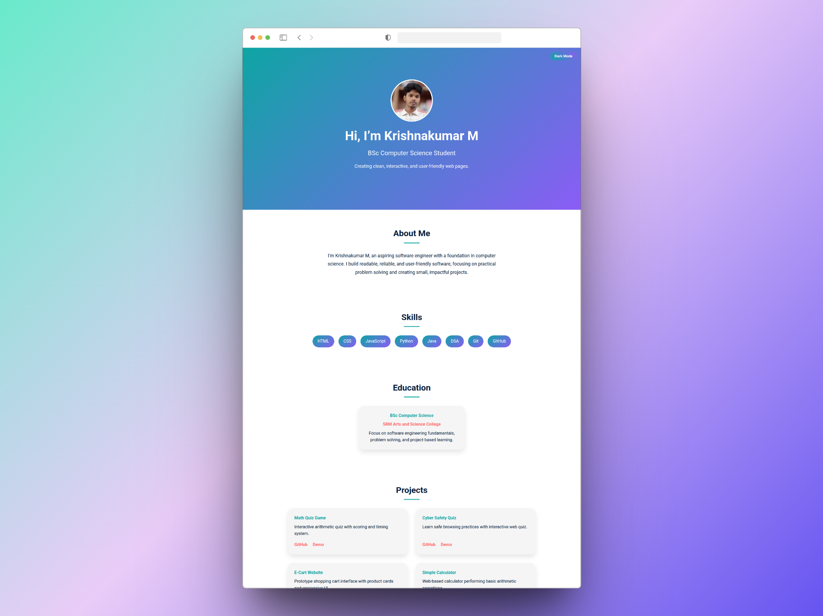
Project Overview
This portfolio website is designed to be responsive and interactive, featuring sections that effectively showcase personal information, skills, projects, education, and contact details for professional branding.

Slide 6



End Users
End users are the people who experience the final output of my work.
I focus on creating clean, user-friendly designs that meet their needs.
EXAMINERS
Evaluating skills
RECRUITERS
Seeking talent
EMPLOYERS
Hiring professionals

Slide 7


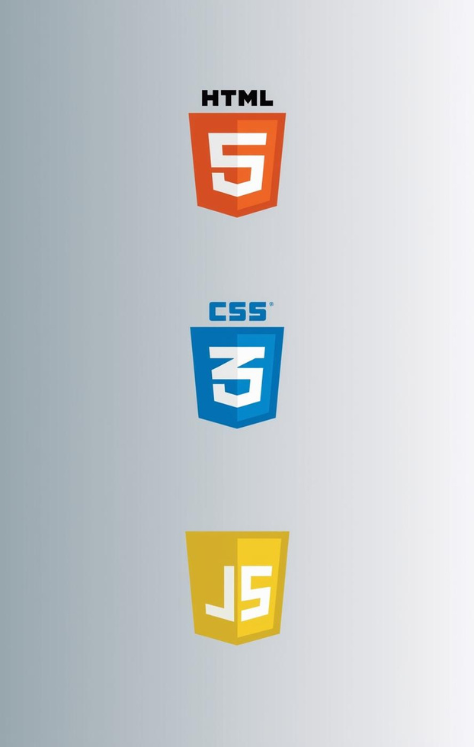
Tools and Technologies
VS CODE
Code Editor
GIT/GITHUB
Version Control
HTML , CSS , JS
Web Technologies

Slide 8
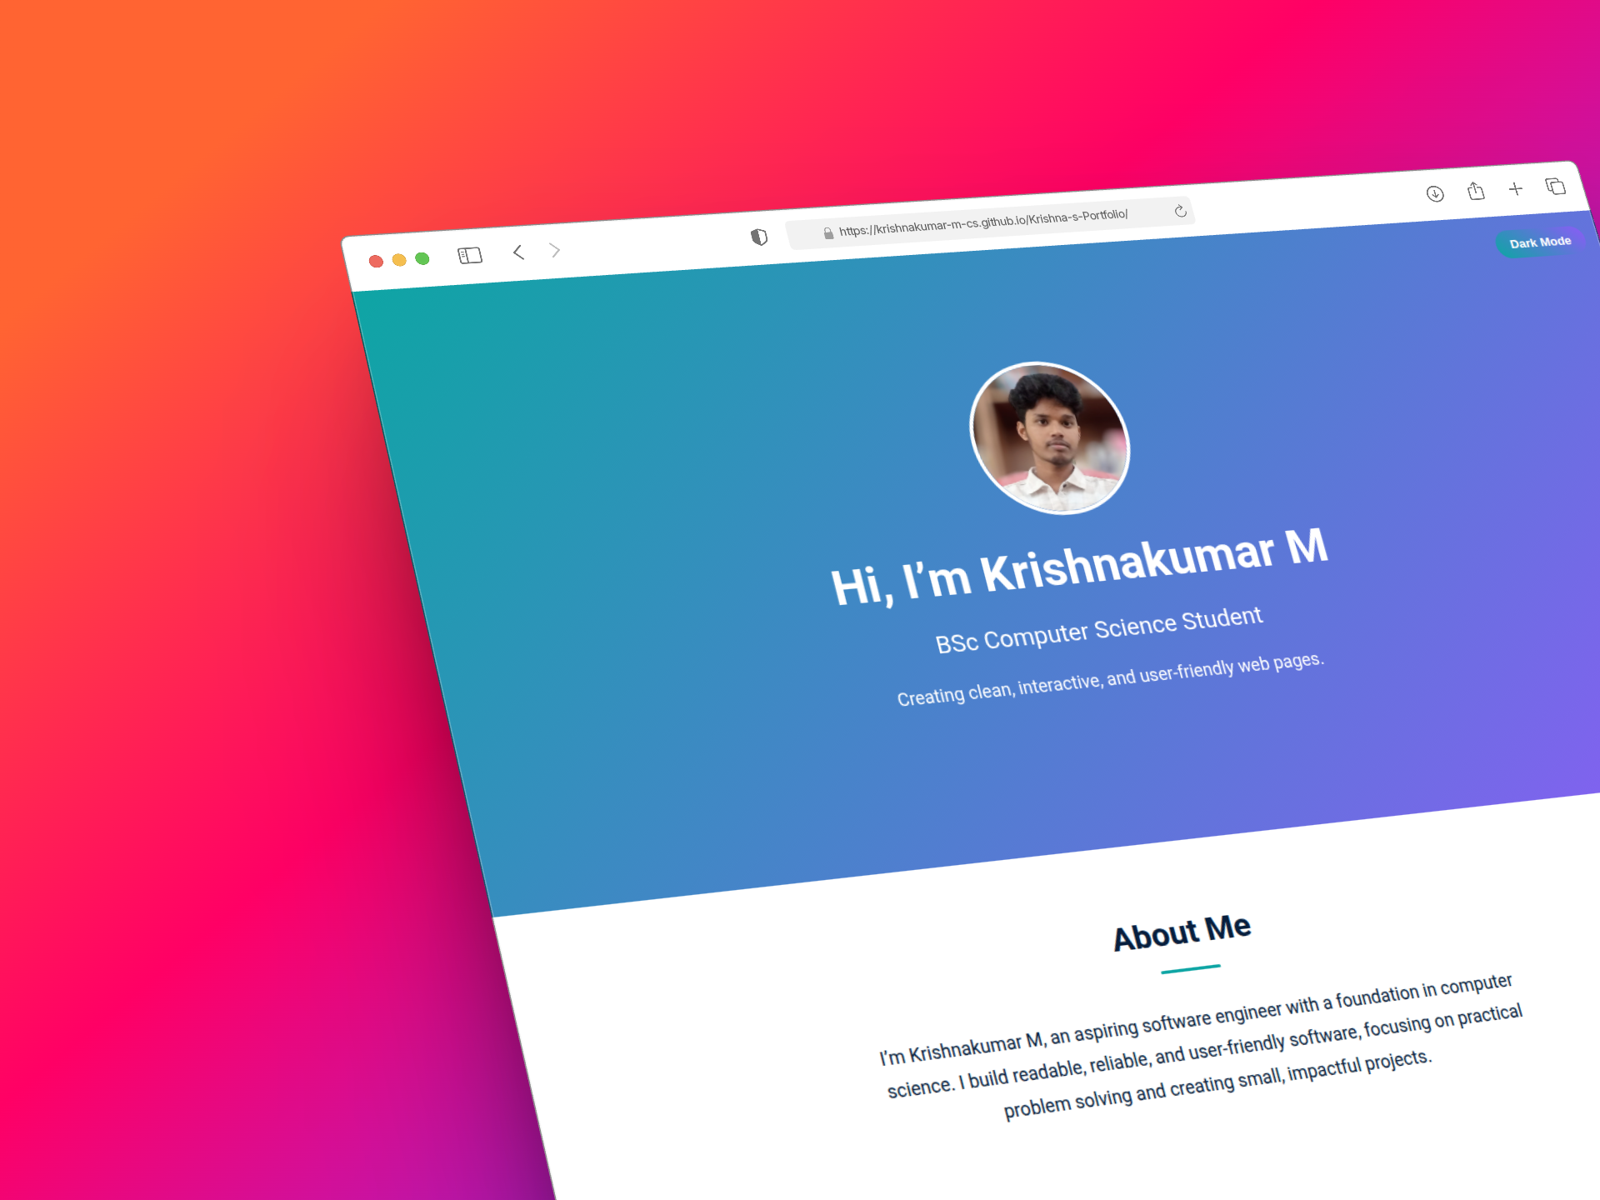
Portfolio Design and Layout
The portfolio features a single-page layout with smooth scrolling and distinct sections for seamless navigation, ensuring an engaging user experience while showcasing essential information effectively.

Slide 9
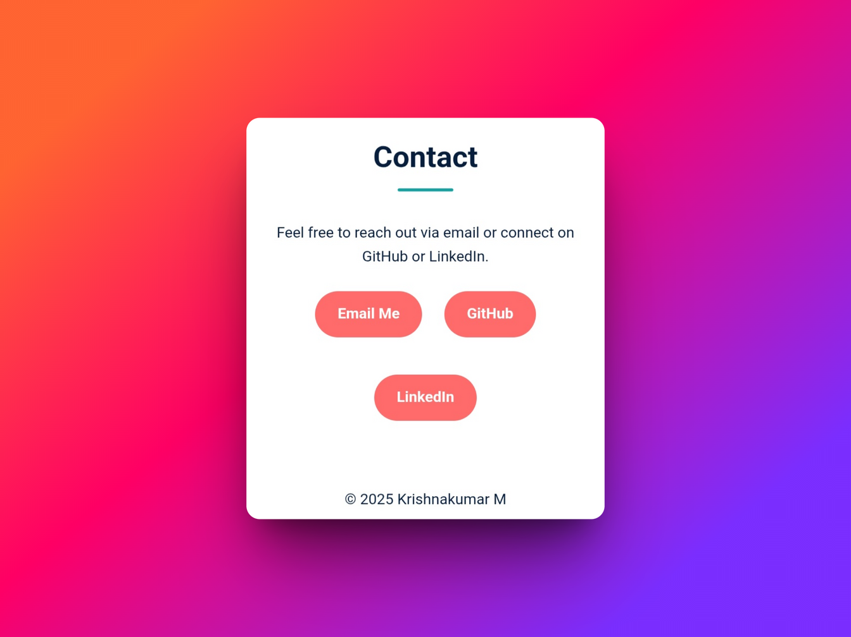
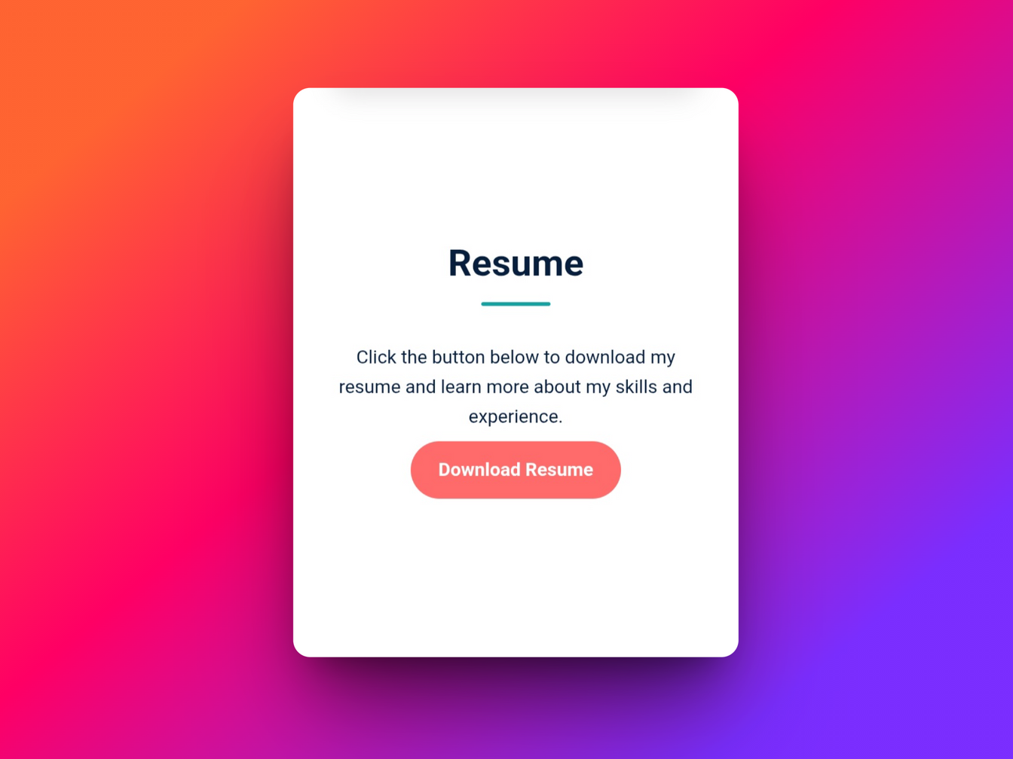
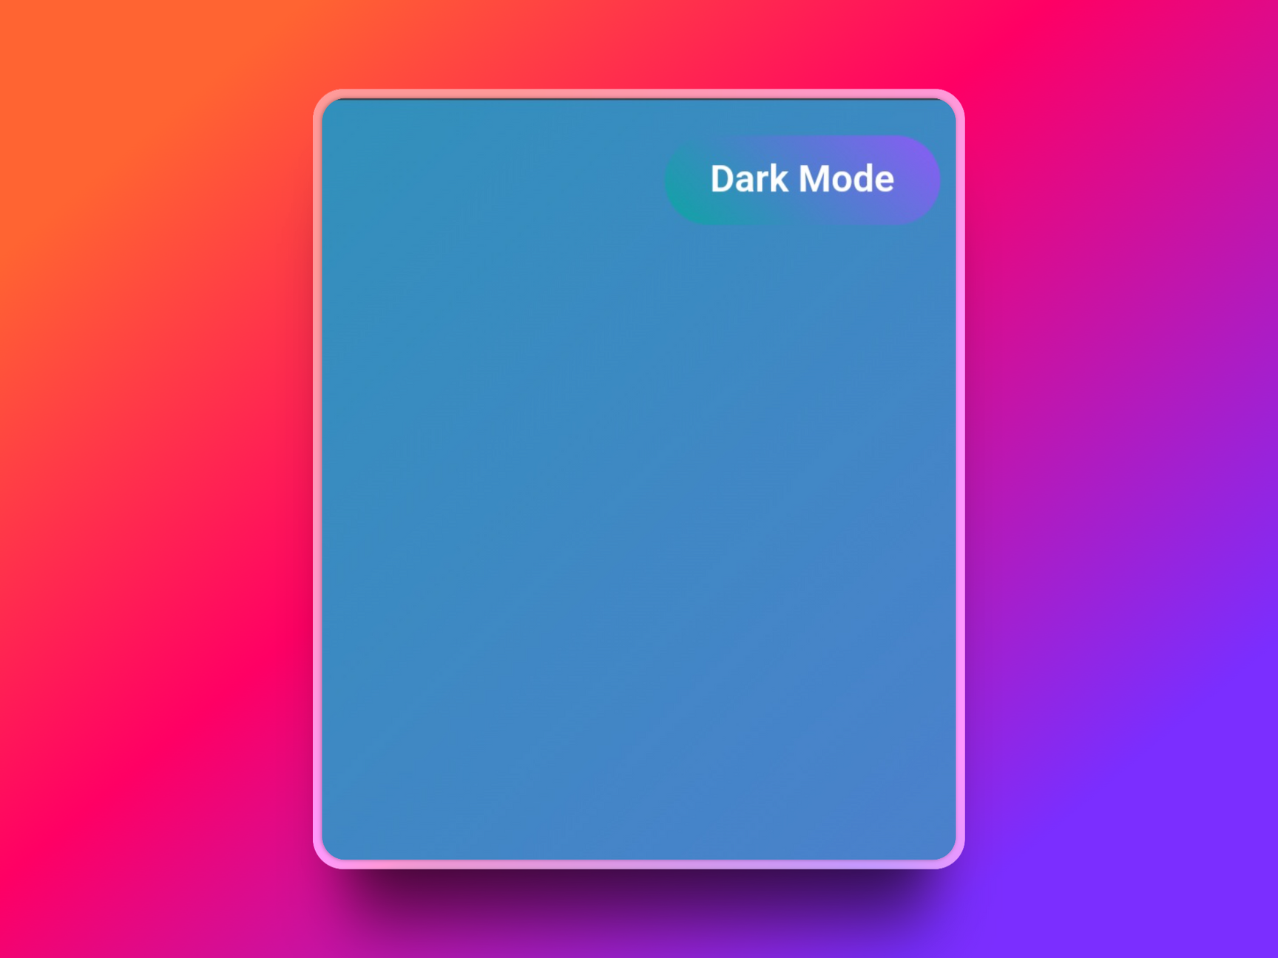
Features and Functionality
CONTACT SECTION
Lets users contact me easily
DOWNLOADABLE RESUME
Easy access
DARK MODE
User-friendly experience

Slide 10
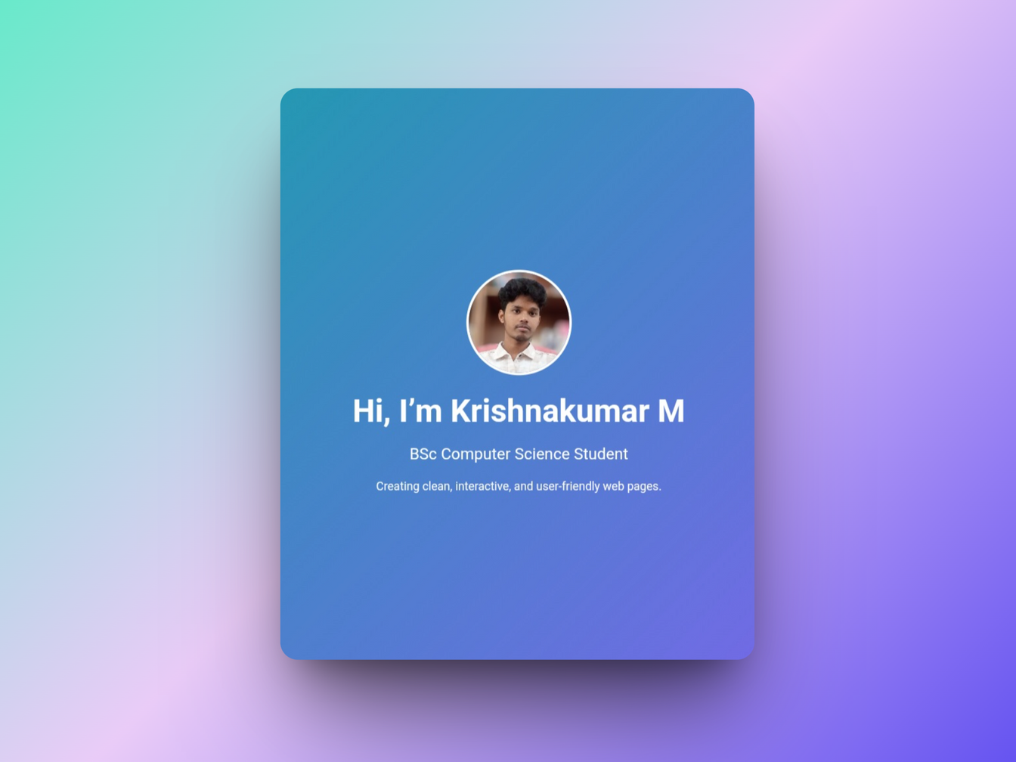
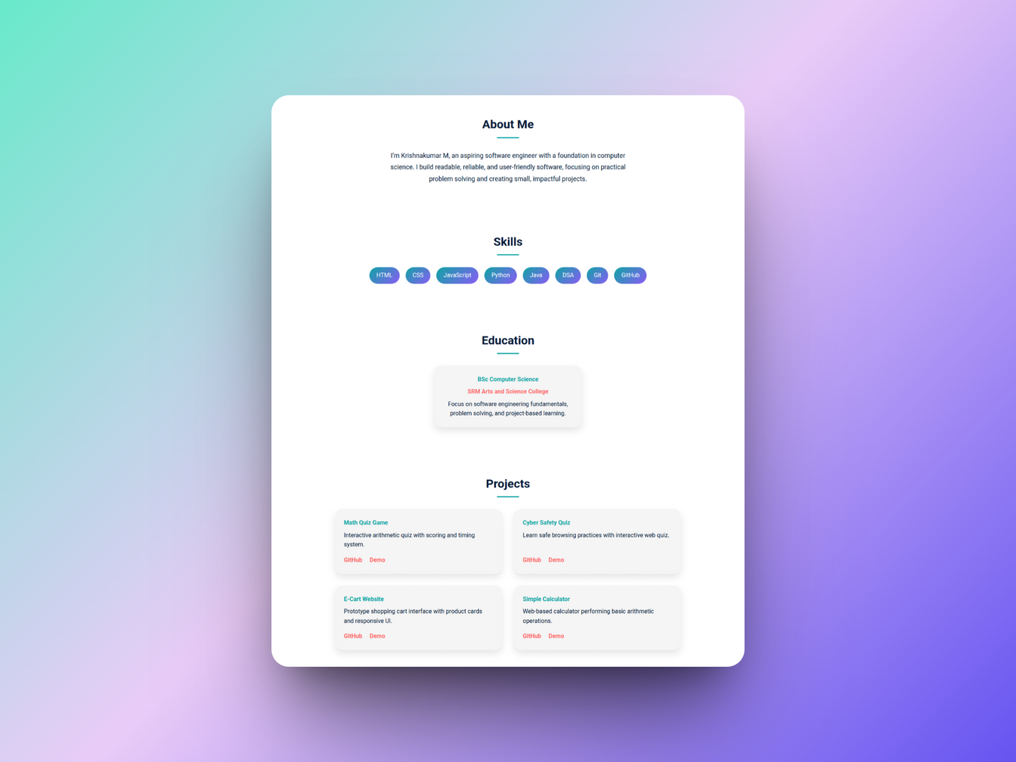
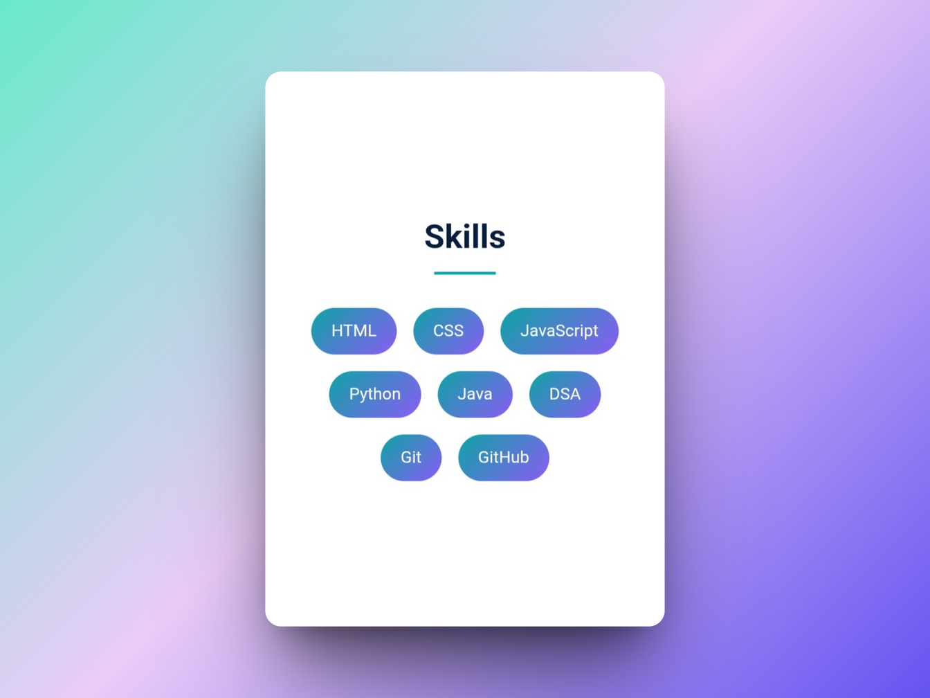
Key Sections of the Portfolio
HERO SECTION
Engaging Introduction
ABOUT SECTION
Personal Background
SKILLS SECTION
Highlighted Expertise

Slide 11

GitHub Link
https://github.com/Krishnakumar-M-CS/Krishna-s-Portfolio.git

Slide 12

Conclusion
The portfolio website efficiently represents all essential details through a clean and organized layout. It maintains consistency in design, responsiveness, and accessibility.
This makes it a reliable platform for presenting professional work and achievements.

Slide 13
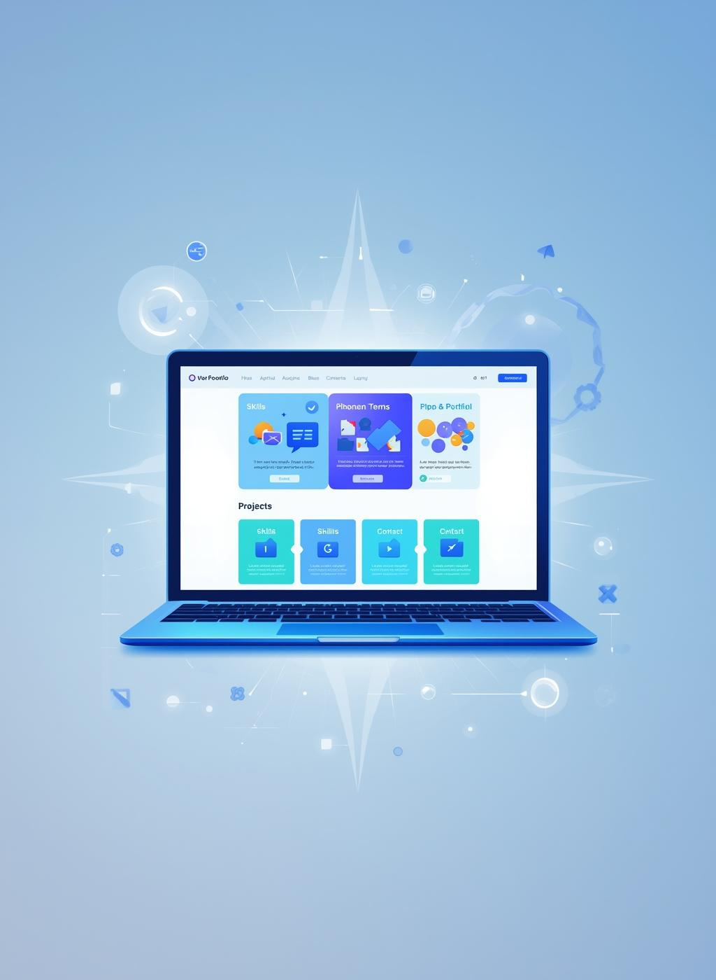
Conclusion
Thank You
“Your online presence matters for success”
– KRISHNAKUMAR M.

